Slide 1



Good Morning!
How are you doing ?
Stay Healthy, Stay Biking

Slide 2
Introducing
Stay Healthy, Stay Biking

Slide 3

g
What is reenbike?
Stay Healthy, Stay Biking

Slide 4

A mobile application that helps the user to find transportations through bikes
Stay Healthy, Stay Biking

Slide 5
g
Why reenbike?
Stay Healthy, Stay Biking

Slide 6

Problems
1. It is hard to get cheap Transportations
2. Global Warming
3. People nowadays are easier to get obesity
4. People nowadays don’t have much time for exercise
Stay Healthy, Stay Biking

Slide 7

1. People want to get healthy
Opportunities
2. People want cheap transportations
3. People want easy transportations
4. People want to reduce emission gas from normal vehicles
5. People wants an easy exercise service
Stay Healthy, Stay Biking

Slide 8
The Solution is
Stay Healthy, Stay Biking

Slide 9
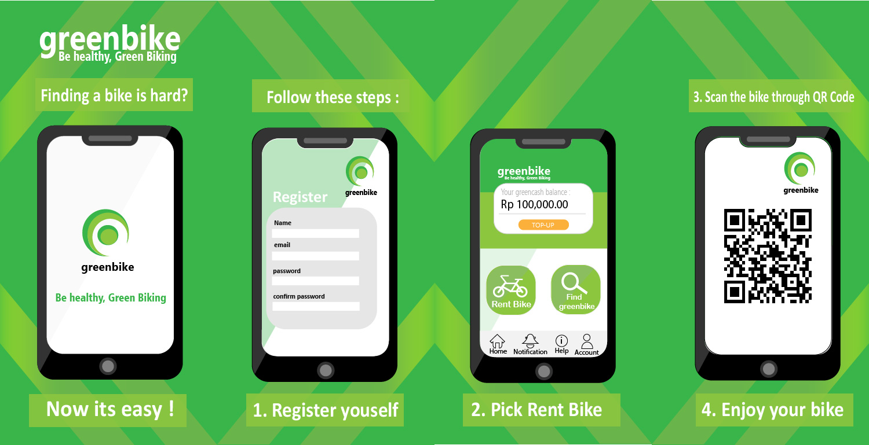
Stay Healthy, Stay Biking

Slide 10
This is the interface when you first open the application
Stay Healthy, Stay Biking

Slide 11
This is the user’s register interface when you want to register yourself to greenbike
Stay Healthy, Stay Biking

Slide 12
This is the user’s register interface when you want to pick our services, please note that you have to go to the nearest rental place which will be informed in the application
Stay Healthy, Stay Biking

Slide 13
This is the user’s register interface when you want to rent a bike through QR code that has been placed in the bicycle lock
Stay Healthy, Stay Biking

Slide 14
Any Question?
Stay Healthy, Stay Biking

Slide 15
Thank You
Stay Healthy, Stay Biking

